Slide 1

Solving the 80% Problem
Data Prep for Microsoft AI
Euan Garden
Data & Analytics Nerd
@euanga
euan.garden@outlook.com
Level: Intermediate

Slide 2
Agenda
What is data prep and why is it such a pain
How do we solve it
How is Microsoft helping you solve it

Slide 3
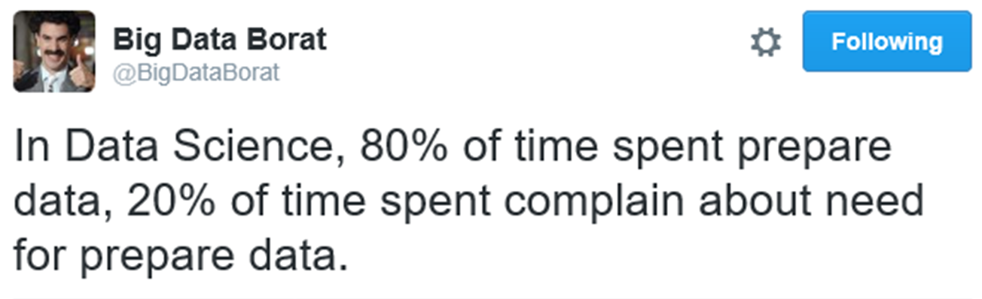
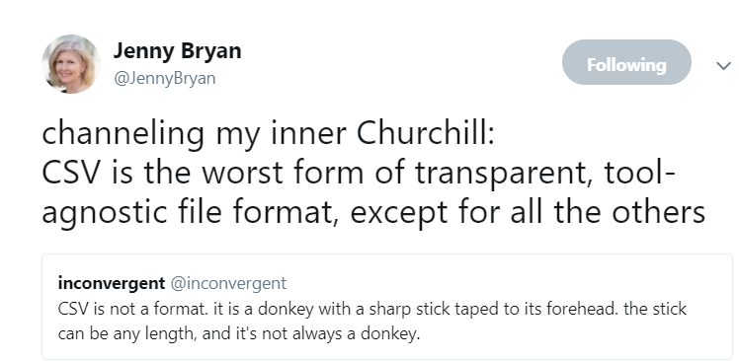
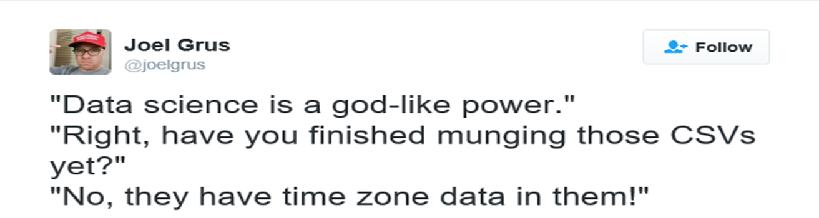

Slide 4
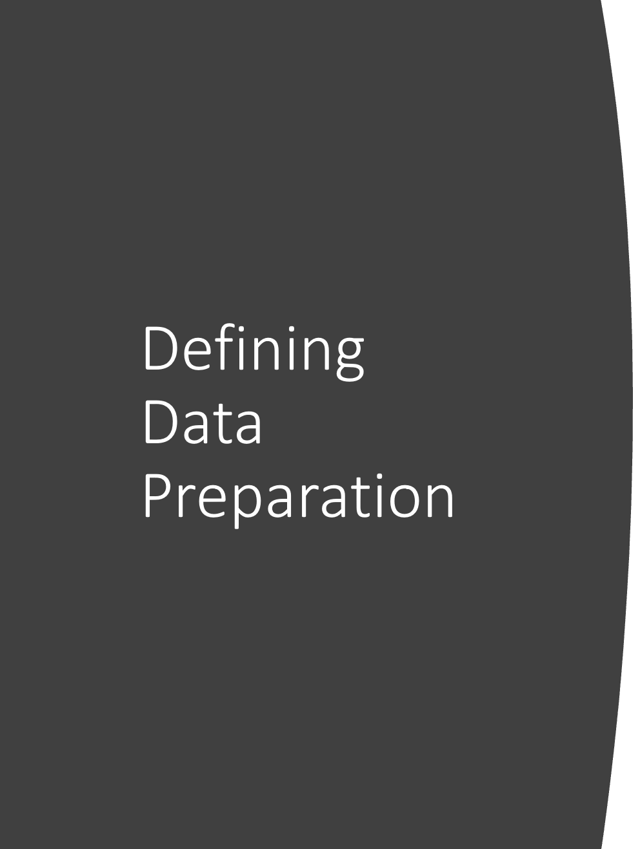
Defining Data Preparation
Data Preparation
Extract Transform & Load (ETL)
Extract Load & Transform (ELT)
Data Wrangling/ Agile Data Preparation
Data Engineering
Notes:
ETT
EAI

Slide 5
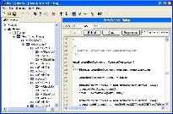
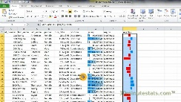
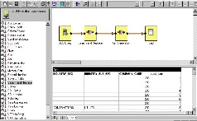
A Data Preparation Journey
Code Centric
Sheet Centric
Graphical
80’s
Early 90’s
Late 90’s
Early 2000’s
70% of Enterprise DW spent on data integration
- Ralph Kimball/Bill Inmon et al

Slide 6
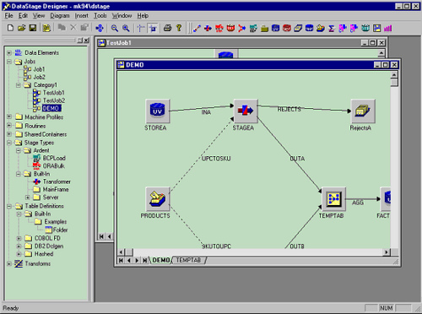
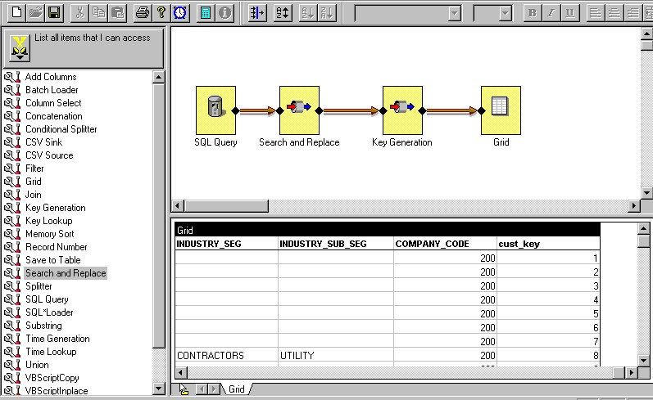
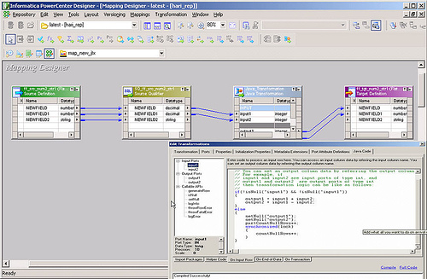
Data Preparation experience has not changed in 20+ years - “Box and Line” ETL - Command line - Discover problems using other tools, fix using ETT/ETL/ELT tools - Known schema to known schema
Notes:
DataStage: Vmark->Ardent->Informix->IBM->Ascential->IBM
ETT: Extract Transform and Transport
ETL: Extract Transform and Load
ELT: Extract Load and Transform

Slide 7

Work well for schema to schema, known target and source mapping
Involve lots of custom code
Limited access to custom libraries
“Batchy”, run, wait for completion, debug cycle
Attached to scale up not scale out architectures
Not cloud friendly

Slide 8
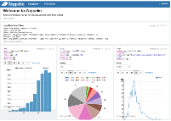
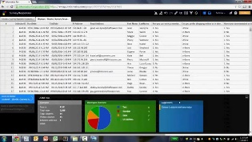
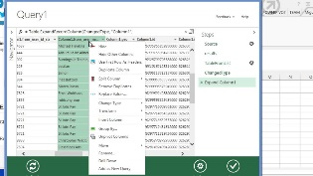
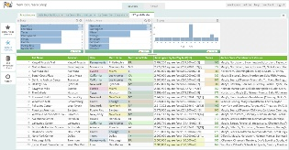
Data Preparation today
Code Centric
Sheet Centric
Graphical
80’s
Early 90’s
Late 90’s
~2010
Agile Data Preparation /
Data Wrangling
70% of Enterprise DW spent on data integration
- Ralph Kimball/Bill Inmon et al
80-90% of Analytic Apps budget on Data prep
- Forrester et al

Slide 9

The act of manipulating raw data into a form that makes it relevant and valuable for consumption by ML algorithms

Slide 10

Customer Challenges and Pain Points
Understanding the semantics of Data is hard and time consuming
Merging data from different sources is too manual
Detecting, troubleshooting and fixing errors is a high tax
Lots of manual, non-scalable work
Data Formatting
Dealing with Dates
“Rectangualising” Data
Custom code always required
Operationalization is HARD

Slide 11
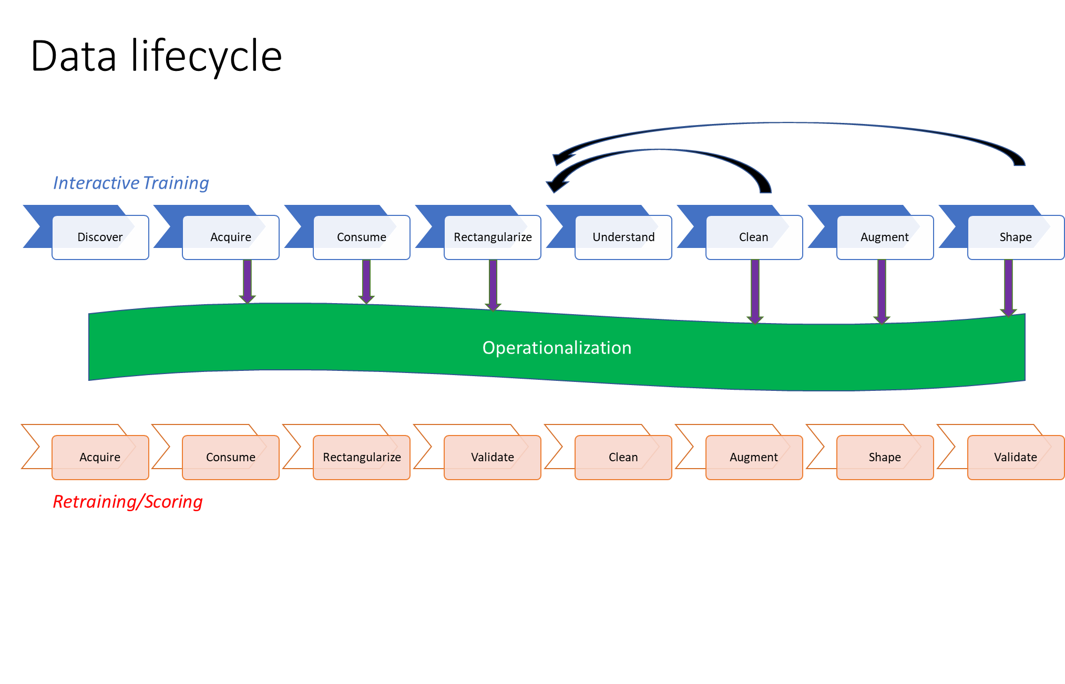

Slide 12
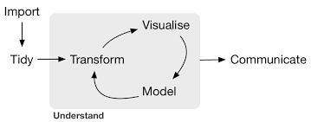
R Community (“TidyVerse”) View

Slide 13
Taxonomy of Work
O16N
Orchestration & Scheduling
Security & Scale
Control Flow
Acquisition & Rectangulization
Feature Engineering
Cleaning & Augmentation

Slide 14
An EDA/Data Prep 10 Step Process
Acquire
Rectangularize
Tidy Format, Pivot/UnPivot, Inconsistent Schema
Data Type & Format/Range verification and assertion
Explore & Understand
Univariate and Multivariate, ToDo List
Missingness/Inconsistency
Skew, Special/Magic/Sentinel Values, Common Sense
Regranularisation, Units of Measure
Imputation
Outliers
Derived Columns
Augmentation & Aggregation
Join, Synthetic Data
ML Specific Feature engineering
Scaling, Encoding, Binning, Feature reduction, different versions for different algorithmic consumers
Prepare for consumption
Training/Test Split

Slide 15
10 Principles
At any/all stages attempt to model & use visualization to check progress,
Use business understanding to review value of data against requirements
Discover the history/journey/lineage of the data you have
Stay iterative & interactive
Filter/Aggregate early
Join/Union late
Drop Columns as early as possible
Drop NA’s as late as possible
Trust no-one!
Embrace Experimentation and Failure

Slide 16


Demo Time
Notes:
Image from Wikipedia Commons

Slide 17
But what about…
Scale
Sampling
Stats vs Actual Data
Visualization
Parralellism
Operationalisation
Be defensive
Package versioning
Orchestration/Pipelining
Training Data Prep <> Inferencing/Scoring Data Prep, potentially
Monitor for Drift/Divergence
Dev Ops

Slide 18
“The idea of imputation is both seductive and dangerous” (R.J.A Little & D.B. Rubin)
Imputation vs Removing Data
Before jumping to the methods of data imputation, we have to understand the reason why data goes missing.
Missing at Random (MAR): Missing at random means that the propensity for a data point to be missing is not related to the missing data, but it is related to some of the observed data
Missing Completely at Random (MCAR): The fact that a certain value is missing has nothing to do with its hypothetical value and with the values of other variables.
Missing not at Random (MNAR): Two possible reasons are that the missing value depends on the hypothetical value (e.g. People with high salaries generally do not want to reveal their incomes in surveys) or missing value is dependent on some other variable’s value (e.g. Let’s assume that females generally don’t want to reveal their ages! Here the missing value in age variable is impacted by gender variable)
Deletion vs Imputation
Deletion
Rows, Columns, Pairwise or more decision to delete
Imputation
Time Series vs Categorical vs Continuous
MICE vs LR vs KNN

